Slide 1
Software Design and Architecture
Session 6

Slide 2
Design
A good design will manage all essential complexities inherent in the problem without adding to accidental complexities consequential to the solutions.

Slide 3
The Object of Good Design
Maintainable:
Cost of system changes is minimal
Readily adaptable to modify existing functionality and enhance functionality.

Slide 4
The Object of Good Design
Design is understandable.
Changes should be local in effect.
Design should be modular.

Slide 5
Goal is:
Low coupling and high cohesion.

Slide 6
S.O.L.I.D Design Principles-Introduction
Intended to make software design more:
Understandable
Flexible
Maintainable

Slide 7
S.O.L.I.D Design Principles History
Originally gathered by
Robert C. Martin

Slide 8
S.O.L.I.D Design Principles
S.O.L.I.D name given by
Michael Feathers

Slide 9
S.O.L.I.D Design Principles
S stands for
Principle
Single Responsibility Principle (SRP)
Objective
Increased Cohesion

Slide 10
S.O.L.I.D Design Principles
O stands for
Principle
Open-Closed Principle (OCP)
Objective
Flexibility, Reusability, and Maintainability
You can achieve it While using Inheritance and Polymorphism

Slide 11
S.O.L.I.D Design Principles
L stands for
Principle
Liskov Substitution Principle (LSP)
Objective
Proper Inheritance (IS A RULE)

Slide 12
S.O.L.I.D Design Principles
I stands for
Principle
Interface Segregation Principle (ISP)
Objective
Deals with non-cohesive interfaces for reducing coupling.

Slide 13
S.O.L.I.D Design Principles
D stands for
Principle
Dependency Inversion Principle (DIP)
Objective
Creation of reusable frameworks. Reduce inter-module coupling.

Slide 14
Single Responsibility Principle (SRP)
A class should have only one reason to change.
It deals with cohesion.

Slide 15
Single Responsibility Principle (SRP)
A class should have only one reason to change.
It deals with cohesion.

Slide 16
Cohesion
Defined as the functional relatedness of the elements of a module.
Related to the force that cause a module, or a class, to change.

Slide 17
Single Responsibility Principle (SRP)
A class should have only one reason to change.
A class has only one responsibility.

Slide 18
What a class does:
The more a class does, the more likely it will change.
The more a class changes, the more likely we will introduce to bugs.

Slide 19
Single Responsibility Principle (SRP) Deals with Coupling & Cohesion
If a class has more than one responsibility:
Low Cohesion
High Coupling (The responsibilities become coupled)

Slide 20
Single Responsibility Principle (SRP) Deals with Coupling & Cohesion
If a class has more than one responsibility:
Low Cohesion
High Coupling (The responsibilities become coupled)

Slide 21
Single Responsibility Principle (SRP) Deals with Coupling & Cohesion
Changes to one responsibility may impair or inhibit the class’s ability to meet the others.
Depends each other.

Slide 22
Single Responsibility Principle (SRP)
SRP one of the simplest of the principles but one of the most difficult to get right.

Slide 23
Single Responsibility Principle (SRP)
Programmer Responsibility:
Finding and separating conjoined responsibilities in much of what software design in really about.

Slide 24
Single Responsibility Principle (SRP)
SRP is the fundamental principle.
Remaining four are depending some how.

Slide 25
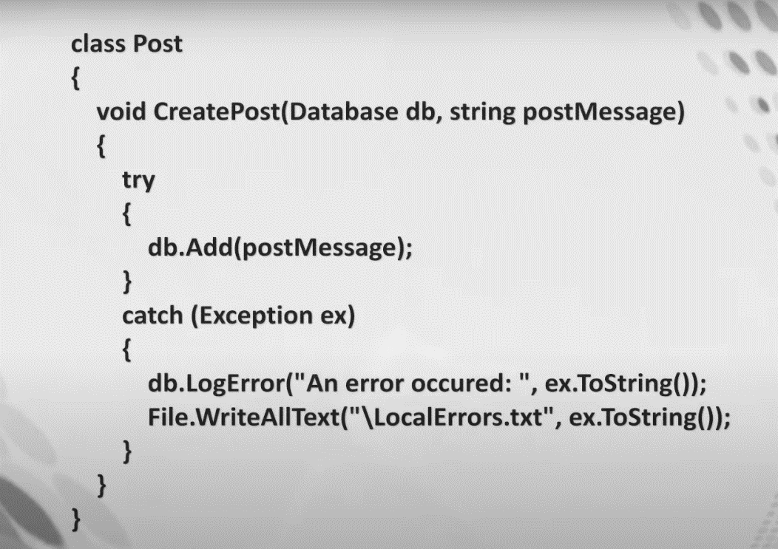
Single Responsibility Principle (SRP) - Example
Create a new post
Log Error

Slide 26
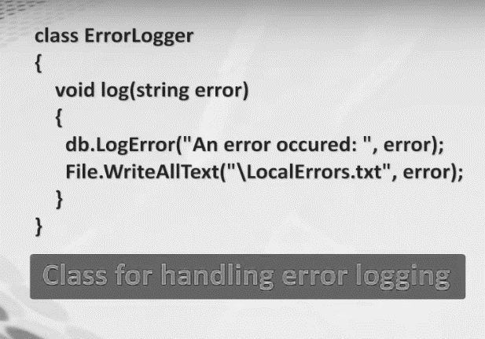
Single Responsibility Principle (SRP) - Example

Slide 27
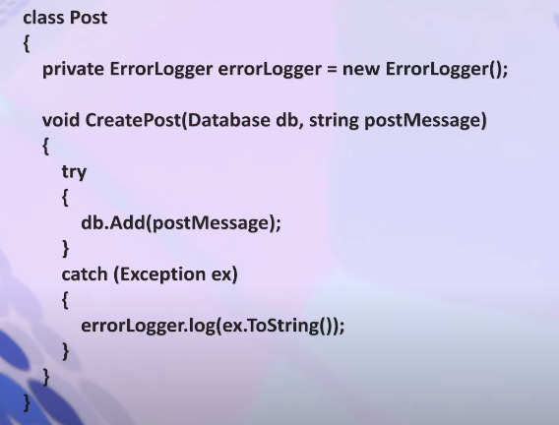
Single Responsibility Principle (SRP) - Example

Slide 28
The Open-Closed Principle (OCP)
A software artifact should be open for extension but closed for modification.
The behavior of a software artifact ought to be extendible, without having to modify that artifact.
Changing without change data, Like variable.

Slide 29
The Open-Closed Principle (OCP)
Not simply a principle that guides in the design of classes and modules.
If simple extensions to the requirements force massive changes to the software, then the architects of that software system have engaged in a spectacular failure.

Slide 30
The Open-Closed Principle (OCP)
Not simply a principle that guides in the design of classes and modules.
If simple extensions to the requirements force massive changes to the software, then the architects of that software system have engaged in a spectacular failure.

Slide 31
The Open-Closed Principle (OCP) – How to Apply
Inheritance
Composition
Association

Slide 32
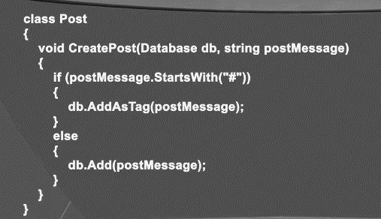
The Open-Closed Principle (OCP) – Example

Slide 33
The Open-Closed Principle (OCP) – Example
What Happens if we had to add a case for
@

Slide 34
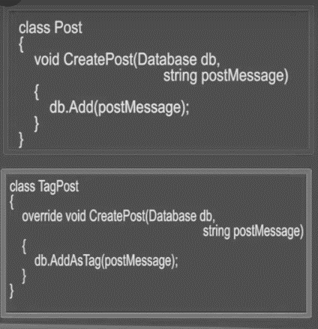
The Open-Closed Principle (OCP) – Example

Slide 35
The Open-Closed Principle (OCP) – Example
Make Separate class for Mention Post instead of changing in main.
Post
Tag Post
Mention Post

Slide 36
Liskov’s Substitution Principle (LSP)
Subtypes must be substitutable for their base types.
Deals with design of inheritance hierarchies.

Slide 37
Liskov’s Substitution Principle (LSP)
Functions that use references to base classes must be able to use objects of derived classes without knowing it.

Slide 38
Liskov’s Substitution Principle (LSP)
Behavior of derived class is not same as base class generally.
Sub classes not behave like base.
Keypad mobile not hold touch behavior.

Slide 39
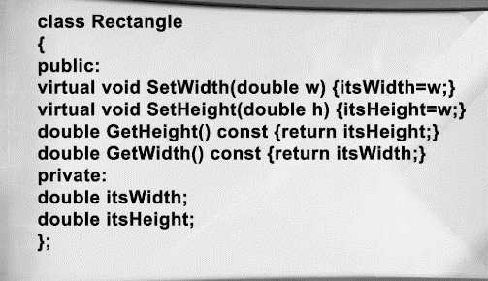
Liskov’s Substitution Principle (LSP) – Example

Slide 40
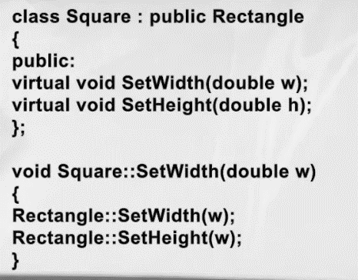
Liskov’s Substitution Principle (LSP) – Example

Slide 41
Liskov’s Substitution Principle (LSP) – Example
In this case;
By setting the width of a square object, its height will change correspondingly and vice versa. The square object will remain a mathematically proper square.

Slide 42
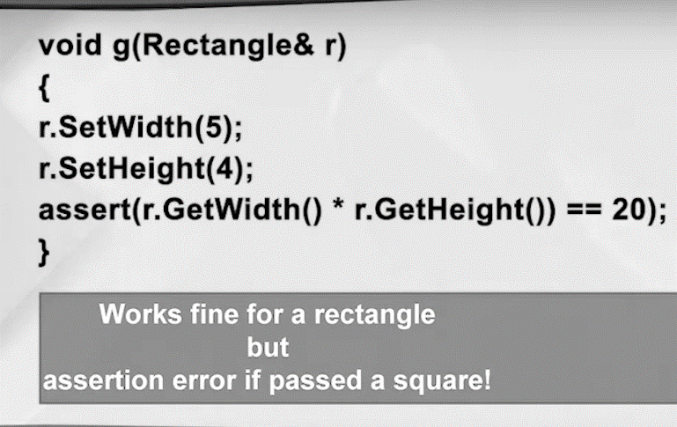
Liskov’s Substitution Principle (LSP) – Example

Slide 43
SOLID Design Principles-Interface Segregation Principle (ISP)
If you have an abstract class or an interface, then the implementers should not be forced to implement parts that they don’t care about.

Slide 44
SOLID Design Principles-Interface Segregation Principle (ISP)
In programming, the interface segregation principle states that no client should be forced to depend on methods it does not use.

Slide 45
SOLID Design Principles-Interface Segregation Principle (ISP)
Put more simple;
Do not add additional functionality to an existing interface by adding new methods.

Slide 46
SOLID Design Principles-Interface Segregation Principle (ISP)
Instead, create a new interface and let your class implement multiple interfaces if needed.

